Slide 1
Network Problem CPM & PERT
Mahfuzul Hoque PhD
Professor,
Department of Accounting & Information Systems
Faculty of Business Studies
University of Dhaka

Slide 2
Network Problem CPM & PERT
Mahfuzul Hoque PhD
Professor,
Department of Accounting & Information Systems
Faculty of Business Studies
University of Dhaka

Slide 3
Introduction
Any project involves planning, scheduling & controlling a number of interrelated activities with use of limited resources, namely, men, machines, materials, money & time.
The projects may be extremely large & complex such as construction of a housing , a highway, a shopping complex etc.
introduction of new products & research & development projects.
It is required that managers must have a dynamic planning & scheduling system to produce the best possible results & also to react immediately to the changing conditions & make necessary changes in the plan & schedule.

Slide 4
A convenient analytical & visual technique of PERT & CPM prove extremely valuable in assisting the managers in managing the projects.
PERT stands for Project Evaluation & Review Technique developed during 1950’s. The technique was developed & used in conjunction with the planning & designing of the Polaris missile project.
CPM stands for Critical Path Method which was developed by DuPont Company & applied first to the construction projects in the chemical industry.
Though both PERT & CPM techniques have similarity in terms of concepts, the basic difference is, PERT is used for analysis of project scheduling problems. CPM has single time estimate & PERT has three time estimates for activities & uses probability theory to find the chance of reaching the scheduled time.

Slide 5
PROJECT MANAGEMENT GENERALLY CONSISTS OF THREE PHASES.
Planning: Planning involves setting the objectives of the project. Identifying various activities to be performed & determining the requirement of resources such as men, materials, machines, etc.
The cost & time for all the activities are estimated, & a network diagram is developed showing sequential interrelationships (predecessor & successor) between various activities during the planning stage.
Scheduling: Based on the time estimates, the start & finish times for each activity are worked out by applying forward & backward pass techniques, critical path is identified, along with the slack & float for the non-critical paths.
Controlling: Controlling refers to analyzing & evaluating the actual progress against the plan. Reallocation of resources, crashing & review of projects with periodical reports are carried out.

Slide 6

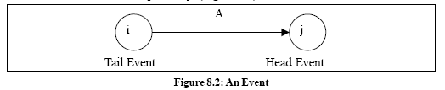
COMPONENTS of PERT/CPM NETWORK
PERT/CPM networks contain two major components (i) Activities, & (ii) Events
Activity: An activity represents an action & consumption of resources (time, money, energy) required to complete a portion of a project. Activity is represented by an arrow, (Figure 8.1).
Event: An event (or node) will always occur at the beginning & end of an activity. The event has no resources & is represented by a circle. The ith event & jth event are the tail event & head event respectively, (Figure 8.2).

Slide 7
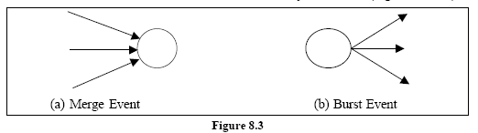
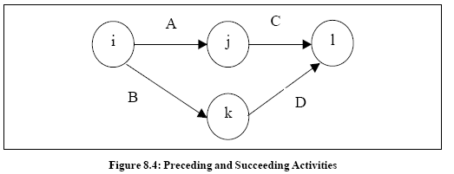
Merge & Burst Events: One or more activities can start & end simultaneously at an event (Figure 8.3 a, b).
Preceding & Succeeding Activities
Activities performed before given events are known as preceding activities (Figure 8.4), & activities performed after a given event are known as succeeding activities.
Activities A & B precede activities C & D respectively.

Slide 8
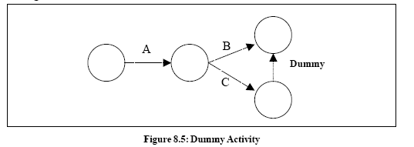
Dummy Activity
An imaginary activity which does not consume any resource & time is called a dummy activity. Dummy activities are simply used to represent a connection between events in order to maintain a logic in the network. It is represented by a dotted line in a network, see Figure 8.5.

Slide 9
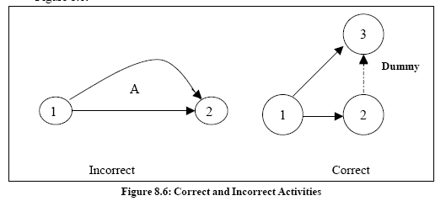
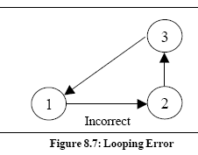
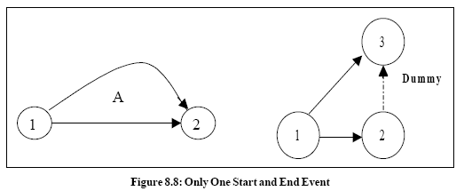
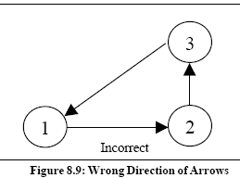
ERRORS TO BE AVOIDED IN CONSTRUCTING A NETWORK
a. Two activities starting from a tail event must not have a same end event. To ensure this, it is absolutely necessary to introduce a dummy activity, as shown in Figure 8.6.
b. Looping error should not be formed in a network, as it represents performance of activities repeatedly in a cyclic manner, as shown below in Figure 8.7.
c. In a network, there should be only one start event & one ending event as shown
below, in Figure 8.8.
d. The direction of arrows should flow from left to right avoiding mixing of direction as shown in Figure 8.9.

Slide 10
RULES IN CONSTRUCTING A NETWORK
No single activity can be represented more than once in a network. The length of an arrow has no significance.
The event numbered 1 is the start event & an event with highest number is the end event. Before an activity can be undertaken, all activities preceding it must be completed. That is, the activities must follow a logical sequence (or – interrelationship) between activities.
In assigning numbers to events, there should not be any duplication of event numbers in a network.
Dummy activities must be used only if it is necessary to reduce the complexity of a network.
A network should have only one start event & one end event.

Slide 11


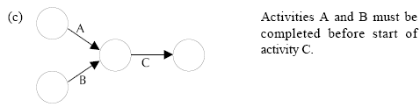
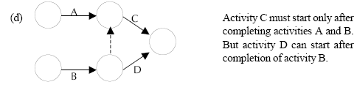
Some conventions of network diagram are shown in Figure 8.10 (a), (b), (c), (d) below:

Slide 12
PROCEDURE FOR NUMBERING THE EVENTS
USING FULKERSON'S RULE
Step1: Number the start or initial event as 1.
Step2: From event 1, strike off all outgoing activities. This would have made one or more events as initial events (event which do not have incoming activities). Number that event as 2.
Step3: Repeat step 2 for event 2, event 3 & till the end event. The end event must have the highest number
Example 1:
Draw a network for a house construction project. The sequence of activities with their predecessors are given in Table 8.1, below.

Slide 13
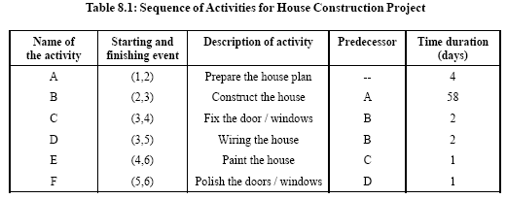
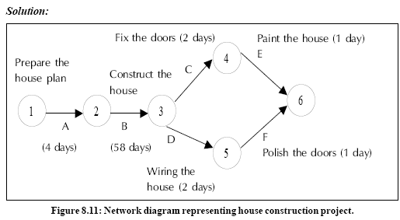

Slide 14
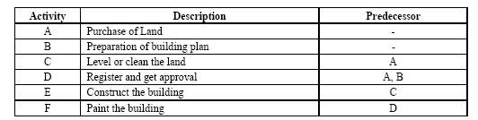
The network diagram in Figure 8.11 shows the procedure relationship between the activities. Activity A (preparation of house plan), has a start event 1 as well as an ending event 2. Activity B (Construction of house) begins at event 2 & ends at event 3. The activity B cannot start until activity A has been completed. Activities C & D cannot begin until activity B has been completed, but they can be performed simultaneously. Similarly, activities E & F can start only after completion of activities C & D respectively. Both activities E & F finish at the end of event 6.
Example 2: Consider the project given in Table 8.2 & construct a network diagram. Table 8.2: Sequence of Activities for Building Construction Project

Slide 15
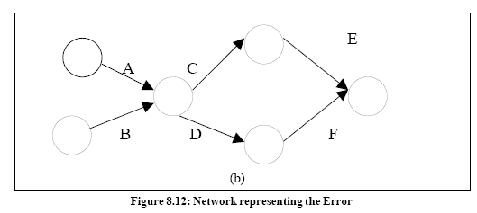
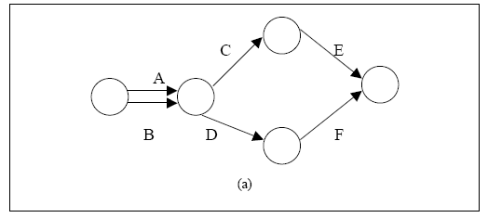
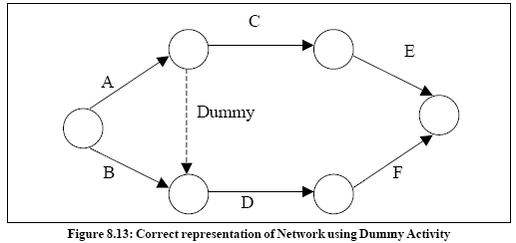
Solution: The activities C & D have a common predecessor A. The network representation shown in Figure 8.12 (a), (b) violates the rule that no two activities can begin & end at the same events. It appears as if activity B is a predecessor of activity C, which is not the case. To construct the network in a logical order, it is necessary to introduce a dummy activity as shown in Figure 8.12.

Slide 16

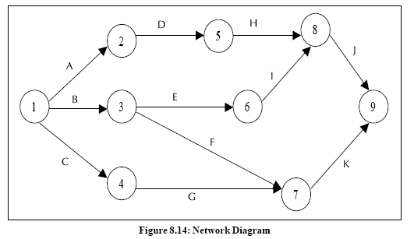
Example 3: Construct a network for a project whose activities & their predecessor relationship are given in Table 8.3.
Solution: The network diagram for the given problem is shown in Figure 8.14 with activities A, B & C starting simultaneously.

Slide 17

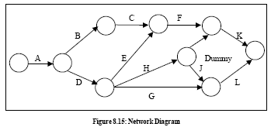
Example 4: Draw a network diagram for a project given in Table 8.4.
Solution: An activity network diagram describing the project is shown in Figure 8.15, below:

Slide 18
CRITICAL PATH ANALYSIS
The critical path for any network is the longest path through the entire network.
Since all activities must be completed to complete the entire project, the length of the critical path is also the shortest time allowable for completion of the project.
Thus if the project is to be completed in that shortest time, all activities on the critical path must be started as soon as possible.
These activities are called critical activities.
If the project has to be completed ahead of the schedule, then the time required for at least one of the critical activity must be reduced.
Further, any delay in completing the critical activities will increase the project duration.

Slide 19
CRITICAL PATH ANALYSIS
The activity, which does not lie on the critical path, is called non-critical activity.
These non-critical activities may have some slack time.
The slack is the amount of time by which the start of an activity may be delayed without affecting the overall completion time of the project.
But a critical activity has no slack.
To reduce the overall project time, it would require more resources (at extra cost) to reduce the time taken by the critical activities to complete.

Slide 20
Scheduling of Activities: Earliest Time (TE) & Latest Time(TL)
Before the critical path in a network is determined, it is necessary to find the earliest & latest time of each event to know the earliest expected time (TE) at which the activities originating from the event can be started & to know the latest allowable time (TL) at which activities terminating at the event can be completed.
Forward Pass Computations (to calculate Earliest, Time TE)
Step 1: Begin from the start event & move towards the end event.
Step 2: Put TE = 0 for the start event.
Step 3: Go to the next event (i.e node 2) if there is an incoming activity for event 2, add calculate TE of previous event (i.e event 1) & activity time.
Step 4: Repeat the same procedure from step 3 till the end event.
Note: If there are more than one incoming activities, calculate TE for all incoming activities & take the maximum value. This value is the TE for event 2.

Slide 21
Backward Pass Computations (to calculate Latest Time TL)
Procedure :
Step 1: Begin from end event & move towards the start event. Assume that the direction of arrows is reversed.
Step 2: Latest Time TL for the last event is the earliest time. TE of the last event.
Step 3: Go to the next event, if there is an incoming activity, subtract the value of TL of previous event from the activity duration time. The arrived value is TL for that event. If there are more than one incoming activities, take the minimum TE value.
Step 4: Repeat the same procedure from step 2 till the start event.

Slide 22
DETERMINATION OF FLOAT AND SLACK TIMES
As discussed earlier, the non – critical activities have some slack or float. The float of an activity is the amount of time available by which it is possible to delay its completion time without extending the overall project completion time.
tij = duration of activity
TE = earliest expected time
TL = latest allowable time
ES_{ij} = earliest start time of the activity
EF_{ij} = earliest finish time of the activity
LS_{ij} = latest start time of the activity
LF_{ij} = latest finish time of the activity
Total Float TFij: The total float of an activity is the difference between the latest start time & the earliest start time of that activity.

Slide 23
Free Float FFij: The time by which the completion of an activity can be delayed from its earliest finish time without affecting the earliest start time of the succeeding activity is called free float.
FF _{ij} = (Ej – Ei) – t_{ij} ....................(3)
FF_{ij} = Total float – Head event slack
Independent Float IFij: The amount of time by which the start of an activity can be delayed without affecting the earliest start time of any immediately following activities, assuming that the preceding activity has finished at its latest finish time.
IF ij = (Ej – Li) – tij ....................(4)
IFij = Free float – Tail event slack
Where tail event slack = Li – Ei
The negative value of independent float is considered to be zero.

Slide 24
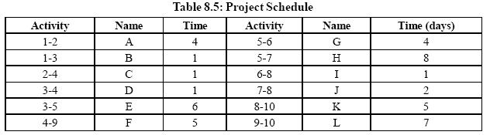
Critical Path:
After determining the earliest & the latest scheduled times for various activities, the minimum time required to complete the project is calculated. In a network, among various paths, the longest path which determines the total time duration of the project is called the critical path. The following conditions must be satisfied in locating the critical path of a network.
An activity is said to be critical only if both the conditions are satisfied.
1. TL – TE = 0
2. TLj – tij – TEj = 0
Example : A project schedule has the following characteristics as shown in Table
i. Construct PERT network.
ii. Compute TE & TL for
each activity.
iii. Find the critical path.

Slide 25
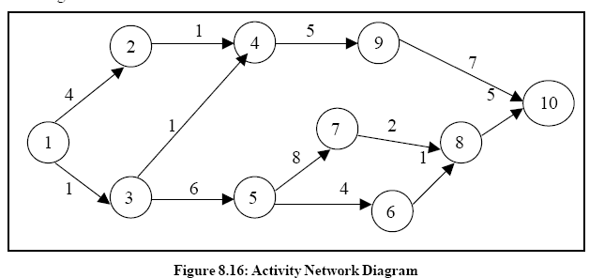
From the data given in the problem, the activity network is constructed as shown in Figure given below

Slide 26
(ii) To determine the critical path, compute the earliest, time TE & latest time TL for each of the activity of the project. The calculations of TE & TL are as follows:,
To calculate TE for all activities
To calculate TL for all activities
TE1 = 0
TE2 = TE1 + t1, 2 = 0 + 4 = 4
TE3 = TE1 + t1, 3 = 0 + 1 =1
TE4 = max (TE2 + t2, 4 & TE3 + t3, 4)
= max (4 + 1 & 1 + 1) = max (5, 2)
= 5 days
TL10 = TE10 = 22
TL9 = TE10 – t9,10 = 22 – 7 = 15
TL8 = TE10 – t8, 10 = 22 – 5 = 17
TL7 = TE8 – t7, 8 = 17 – 2 = 15
TL6 = TE8 – t6, 8 = 17 – 1 = 16
TL5 = min (TE6 – t5, 6 & TE7 – t5, 7)
= min (16 – 4 & 15 –8) = min (12, 7)
= 7 days
TE5 = TE3 + t3, 6 = 1 + 6 = 7
TE6 = TE5 + t5, 6 = 7 + 4 = 11
TE7 = TE5 + t5, 7 = 7 + 8 = 15
TE8 = max (TE6 + t6, 8 & TE7 + t7, 8)
= max (11 + 1 & 15 + 2) = max (12, 17)
= 17 days
TE9 = TE4 + t4, 9 = 5 + 5 = 10
TL4 = TL9 – t4, 9 = 15 – 5 =10
TL3 = min (TL4 – t3, 4 & TL5 – t3, 5 )
= min (10 – 1 & 7 – 6) = min (9, 1)
= 1 day
TL2 = TL4 – t2, 4 = 10 – 1 = 9
TL1 = Min (TL2 – t1, 2 & TL3 – t1, 3)
= Min (9 – 4 & 1 – 1) = 0
TE10 = max (TE9 + t9, 10 & TE8 + t8, 10)
= max (10 + 7 & 17 + 5) = max (17, 22)
= 22 days

Slide 27
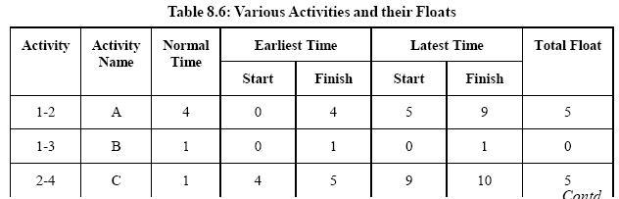
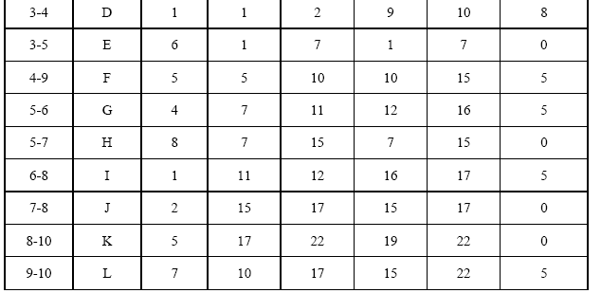

Slide 28
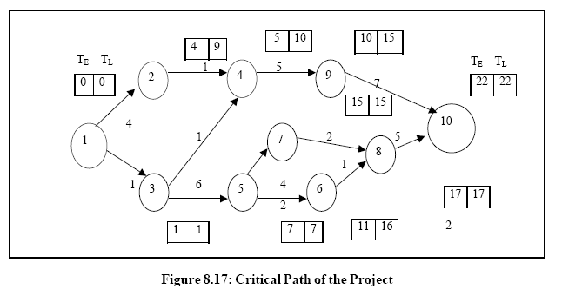
(iii) From the Table 8.6, we observe that the activities 1 – 3, 3 – 5, 5 – 7,7 – 8 & 8 – 10 are critical activities as their floats are zero.

Slide 29
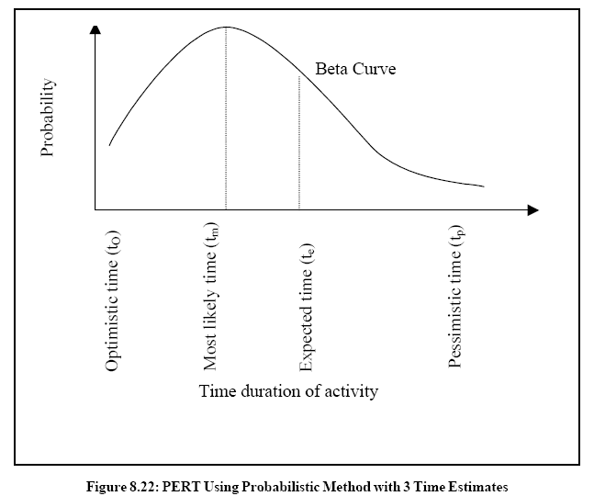
PROJECT EVALUATION REVIEW TECHNIQUE, (PERT)
In the critical path method, the time estimates are assumed to be known with certainty. In certain projects like research & development, new product introductions, it is difficult to estimate the time of various activities.
Hence PERT is used in such projects with a probabilistic method using three time
estimates for an activity, rather than a single estimate, as shown in Figure 8.22.
Optimistic time tO:
It is the shortest time taken to complete the activity. It means that if everything goes well then there is more chance of completing the activity within this time.
Most likely time tm:
It is the normal time taken to complete an activity, if the activity were frequently repeated under the same conditions.
Pessimistic time tp:
It is the longest time that an activity would take to complete. It is the worst time estimate that an activity would take if unexpected problems are faced.

Slide 30



Taking all these time estimates into consideration, the expected time of an activity is arrived at.
The average or mean (ta) value of the activity duration is given by,
The variance of the activity time is calculated using the formula,
Probability for Project Duration
The probability of completing the project within the scheduled time (Ts) or contracted time may be obtained by using the standard normal deviate where Te is the expected time of project completion.
Probability of completing the project within the scheduled time is,

Slide 31
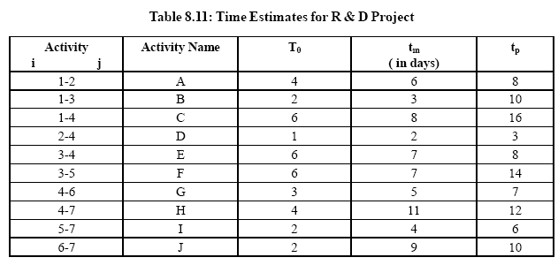
Example
An R & D project has a list of tasks to be performed whose time estimates are given in the Table 8.11, as follows.
a. Draw the project network.
b. Find the critical path.
c. Find the probability that the project is completed in 19 days. If the
probability is less that 20%, find the probability of completing it in 24 days.

Slide 32

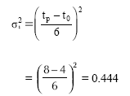
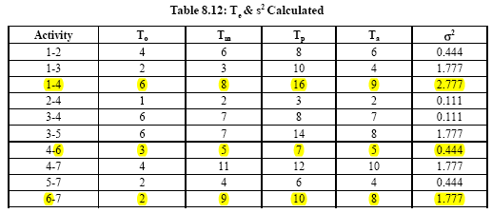
Time expected for each activity is calculated using the formula (5):
Similarly, the expected time is calculated for all the activities.
The variance of activity time is calculated using the formula (6).
Similarly, variances of all the activities are calculated.

Slide 33
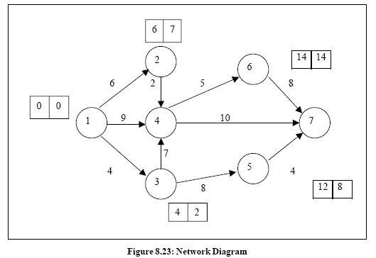
Construct a network diagram:
calculate the time earliest, TE & time Latest TL for all the activities.
From the network diagram Figure 8.24, the critical path is identified as 1-4, 4-6, 6-7, with a project duration of 22 days.

Slide 34
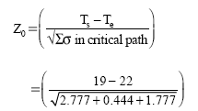


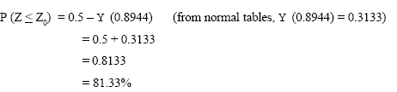

The probability of completing the project within 19 days is given by, P (Z< Z0)
To find Z0 ,
we know, P (Z <Z Network Model 0) = 0.5 – z (1.3416) (from normal tables, z (1.3416) = 0.4099)
= 0.5 – 0.4099
= 0.0901
= 9.01%
Thus, the probability of completing the R & D project in 19 days is 9.01%.
Since the probability of completing the project in 19 days is less than 20% As in question, we find the probability of completing it in 24 days.

Slide 35
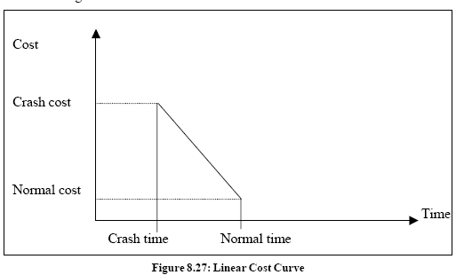
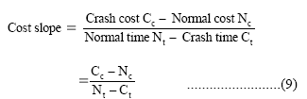
COST ANALYSIS
The two important components of any activity are the cost & time. Cost is directly proportional to time & vice versa.
For example, in constructing a shopping complex, the expected time of completion can be calculated using be time estimates of various activities. But if the construction has to the finished earlier, it requires additional cost to complete the project. We need to arrive at a time / cost trade-off between total cost of project & total time required to complete it.
Normal time:
Normal time is the time required to complete the activity at normal conditions & cost.
Crash time:
Crash time is the shortest possible activity time; crashing more than the normal time will increase the direct cost.
Cost Slope
Cost slope is the increase in cost per unit of time saved by crashing. A linear cost curve
is shown in Figure 8.27.

Slide 36


Example
An activity takes 4 days to complete at a normal cost of Rs. 500.00. If it is possible to complete the activity in 2 days with an additional cost of Rs. 700.00, what is the incremental cost of the activity?
Incremental Cost or Cost Slope
It means, if one day is reduced we have to spend Rs. 100/- extra per day.
Project Crashing
Procedure for crashing
Step1: Draw the network diagram & mark the Normal time & Crash time.
Step2: Calculate TE & TL for all the activities.
Step3: Find the critical path & other paths.
Step 4: Find the slope for all activities & rank them in ascending order.

Slide 37
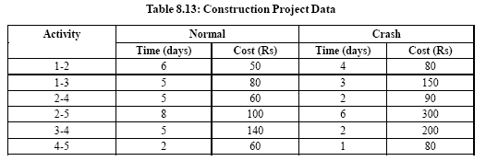
Step 5: Establish a tabular column with required field.
Step 6: Select the lowest ranked activity; check whether it is a critical activity. If
so,crash the activity, else go to the next highest ranked activity.
Note: The critical path must remain critical while crashing.
Step 7: Calculate the total cost of project for each crashing
Step 8: Repeat Step 6 until all the activities in the critical path are fully
crashed.
Example
The following Table 8.13 gives the activities of a construction project & other data.
If the indirect cost is Rs. 20 per day, crash the activities to find the minimum duration of the project & the project cost associated.

Slide 38
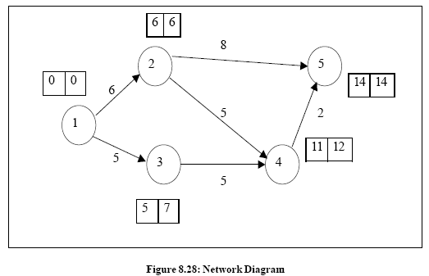
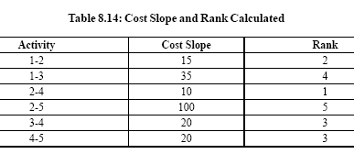


Solution
From the data provided in the table, draw the network diagram (Figure 8.28)
& find the critical path.
From the diagram, we observe that the critical path is 1-2-5 with project duration of
14 days
The cost slope for all activities & their rank is calculated as shown in Table 8.14

Slide 39
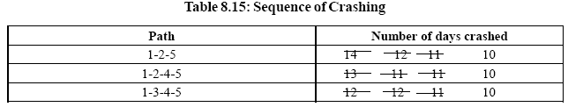
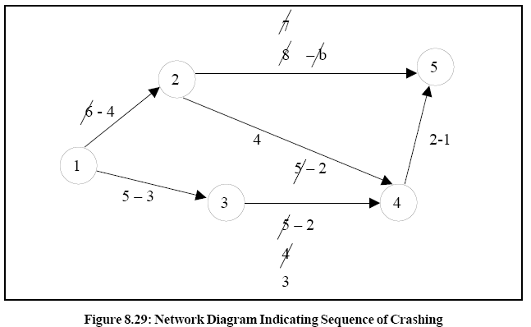
The available paths of the network are listed down in Table 8.15 indicating the sequence of crashing (see Figure 8.29).
The sequence of crashing & the total cost involved is given in Table 8.16 Initial direct cost = sum of all normal costs given
= Rs. 490.00

Slide 40
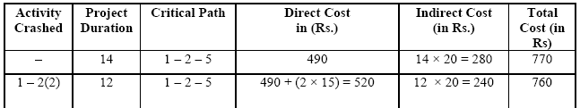
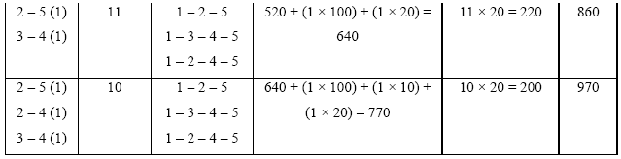
It is not possible to crash more than 10 days, as all the activities in the critical path are fully crashed. Hence the minimum project duration is 10 days with the total cost of Rs. 970.00.

Slide 41
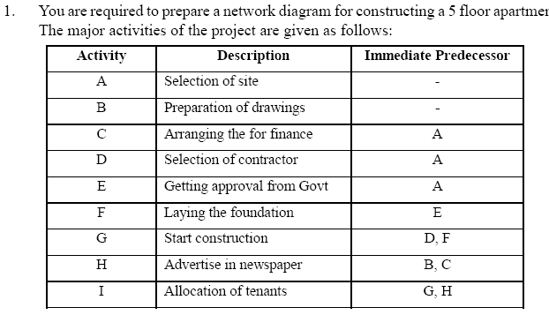
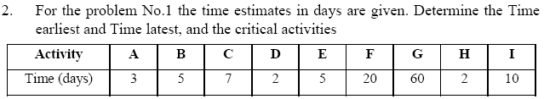
Assignment

Slide 42
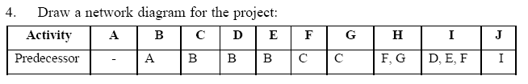
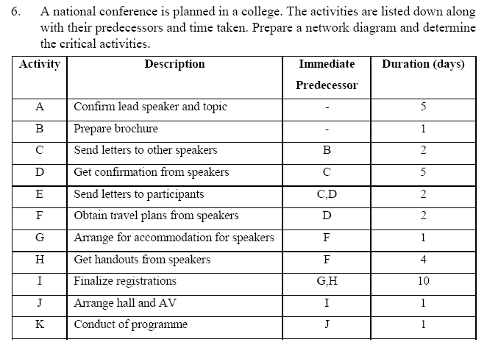

Slide 43
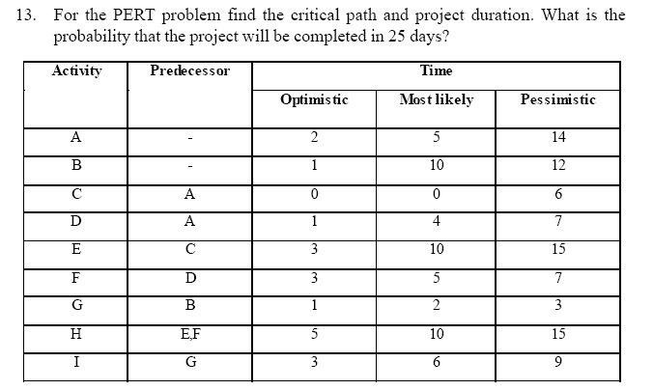

Slide 44
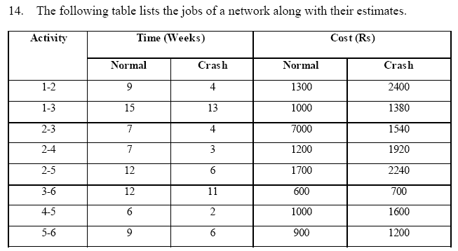
a. Draw the project network diagram.
b. Calculate the length & variance of the critical path.
c. What is the probability that the jobs on the critical path can be
completed in 41 days?

